Slide 1
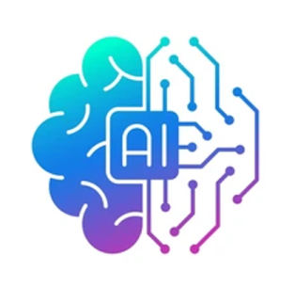
AI Business Assistant

Slide 2
Agenda
Use case
Architecture overview
Tech stack overview
Lessons learned/Recommendations
Demo

Slide 3
Agenda
Use case
Architecture overview
Tech stack overview
Lessons learned/Recommendations
Demo

Slide 4
Agenda
Use case
Architecture overview
Tech stack overview
Lessons learned/Recommendations
Demo

Slide 5
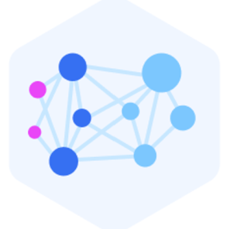
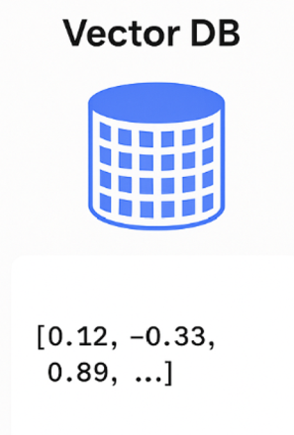

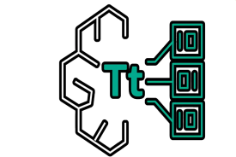


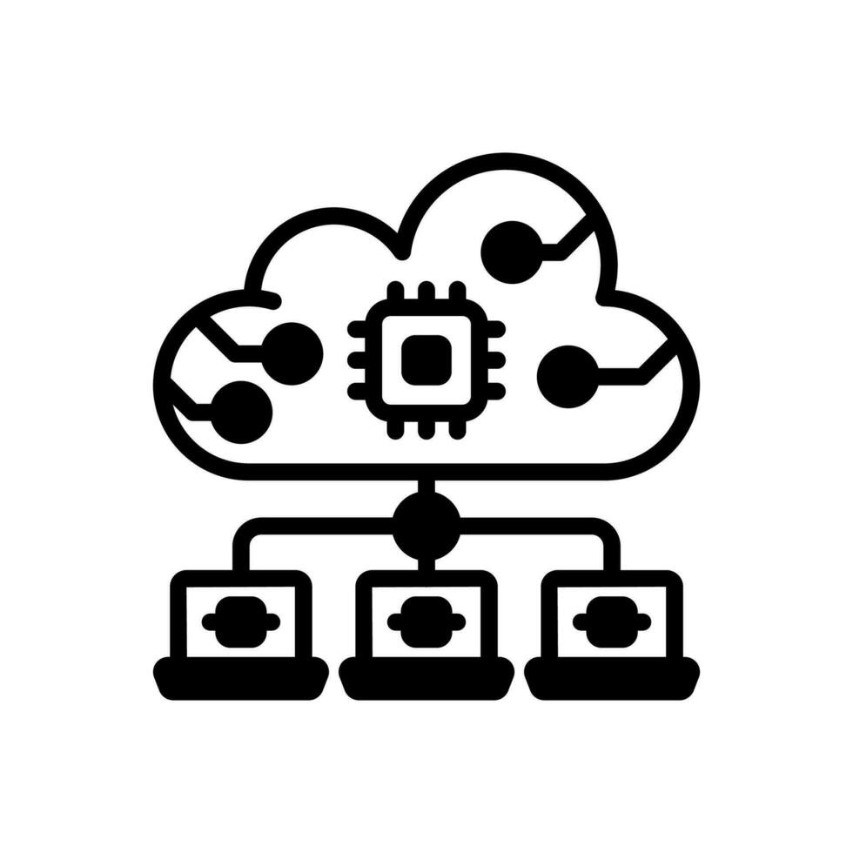
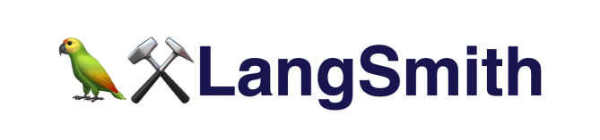
AI Business Assistant
Query prompt
Semantic search Top_K
Inject knowledge base
Chain, memory, workflow, traces
Call LLM + Query + Context
Monitoting, observability

Slide 6
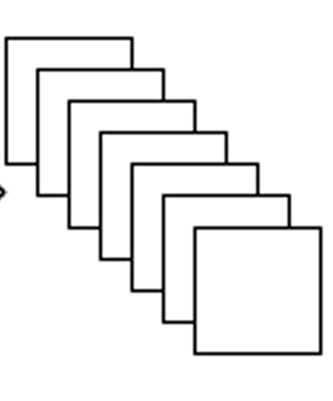
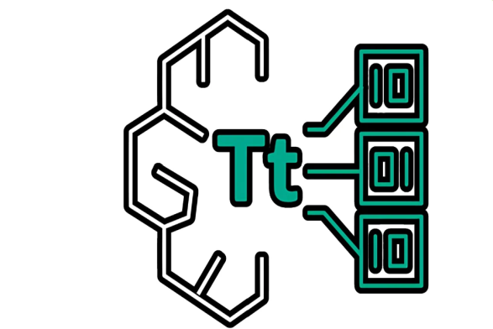


RAG
1
2
Disclosure Public Data
Split into
Chunks
Embedding
3
6
Response
Prompt question
+
Context`
5
4
Large language model

Slide 7
Features
Multi- agent workflow implemented using LangGraph for advanced orchestration
Amazon Bedrock LLM
with enhanced callback integration for better tracing
PostgreSQL/pgvector optimized for 1024-dimensional embeddings with debug logging
S3 integration for document ingestion and batch processing
Comprehensive error handling with detailed logging and user feedback
Memory persistence across app restarts with session state synchronization

Slide 8
Agenda
Use case
Architecture overview
Tech stack overview
Lessons learned/Recommendations
Demo

Slide 9


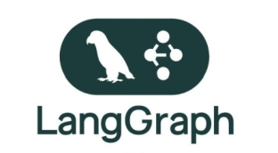
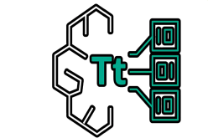
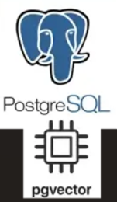
Tech stack
Streamlit is an open-source Python framework that lets you build interactive
web apps for dta science, machine learning, and visualization
It is an observability and analytics dashboard for AI apps
showing you exactly what your LLMs, chains, and agents are doing under the hood.
LangChain is an open-source framework designed to make
it easier to build applications powered by large language models (LLMs)
LangGraph is an open-source framework for building stateful, multi-agent, and long-running LLM workflows using a graph-based architecture.
Titan Embeddings V2 is a text-embedding model It converts input text (words, sentences, paragraphs, or longer documents) into high-dimensional vector embeddings (numerical lists) that capture semantic meaning.
Pgvector is an open-source PostgreSQL extension that adds vector (embedding) data types and similarity search capabilities to PostgreSQL.

Slide 10
Agenda
Use case
Architecture overview
Tech stack overview
Lessons learned/Recommendations
Demo

Slide 11
Lessons Learned/Recommendations
1. Start developing locally or hybrid and keep updating your target architecture (e.g. cloudformation template).
2. Have a robust monitoring system in place.
3. Go premium, starting at just 10 bucks/month!
4. Have a failback mechanism, degrade gracefully.
5. Stay curious.

Slide 12
Agenda
Use case
Architecture overview
Tech stack overview
Lessons learned/Recommendations
Demo

